Slide 1
Weekly Update
Late To the Party Team
Brian Zhang, Saurav Chatterjee, Zachary Stephens
Faculty Advisor: John Leonard
Sponsor: Michael Karafotis
12/2/2019

Slide 2
Goals for the past two weeks
Create nodes from our data file
Create walls around our model so the nodes don’t drift off screen once we populate the map with lots of extra nodes
Alternatively, create a zoom function to allow greater visibility
Automate system for patching iffy data (Some was deliberately left blank or erroneous)

Slide 3
Updated Goals as of last week
Create a dashboard to work through multiple visualizations
Saurav on Dashboard
Brian on Sankey Visualization
Zachary on Force-diagram Visualization
Remove bad data from testing data
Cleaning and screening this data automatically in the code does not actually contribute to the visualization project
It’s just busy work
Cleaning up bad data also falls under scope creep
Move our cleaned data into a database to be worked with from all three components of our visualization
Dashboard, Sankey, Force-diagram

Slide 4
Accomplishments/Challenges Encountered
Accomplishments:
We established what we wanted our final rough design to look like and began working on the individual parts
Challenges:
Bad data needs cleaning
Different visualizations may require different formats of data than the ones we were given
We may still need to add quantifiable data to go with the qualifiable data to accommodate Sankey and some of the function of Force-Diagram
Our fake data is currently different for Sankey and Force-Diagram
At some point, we will need to agree on either converting to the data provided by BoA (after cleaning)
OR generate a set of data that we can feasibly project into both visualizations

Slide 5
Goals for This Week
Merging together the ideas that we had into a functioning diagram
This includes displaying the hopefully cleaned bad data that we had received
https://datalab.usaspending.gov/budget-function.html
Create a database to potentially hold the data. Maybe also used in the dashboard.
Work on creating a simulation of the diagram and potentially conduct a small survey on the readability of it

Slide 6
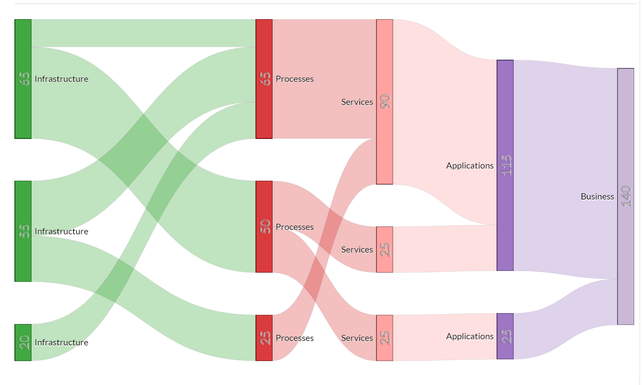
Sankey

Slide 7
Key updates
Our current fork
Notably: New walls, modified force values
https://observablehq.com/@stephenszc/clickable-force-directed-graph-triage

